Slide 1
YOU BE THE JUDGE! A Fair Use Workshop
Rochelle Lundy
&
Maryam Fakouri
March 1, 2018

Slide 2

Happy Fair Use Week!
The fans cheering for Duran Duran at the Apollo, NYC by Andreas Komodromos is licensed under CC BY NC.

Slide 3
A copyright owner “has the exclusive rights to do and to authorize any of the following” (17 USC §106):
• Reproduce a work
• Prepare a derivative work
• Publicly distribute a work
• Publicly display a work
• Publicly perform a work
• In the case of sound recordings, to perform the work publicly via digital audio transmission
Notes:
Single work but plural concept. We should say copyrights.
What do these rights have in common? Why would we protect these things?
They are ways to monetize creative works. Also publicize works.

Slide 4
17 USC §107 Limitations on exclusive rights: Fair use
[F]air use of a copyrighted work . . . for purposes such as criticism, comment, news reporting, teaching . . . scholarship, or research, is not an infringement of copyright. In determining . . . fair use the factors to be considered shall include—
(1) the purpose and character of the use, including whether such use is of a commercial nature or is for nonprofit educational purposes;
(2) the nature of the copyrighted work;
(3) the amount and substantiality of the portion used in relation to the copyrighted work as a whole; and
(4) the effect of the use upon the potential market for or value of the copyrighted work.
Notes:
Educational uses are examples of favored purposes of use. Purpose is one of four factors.

Slide 5
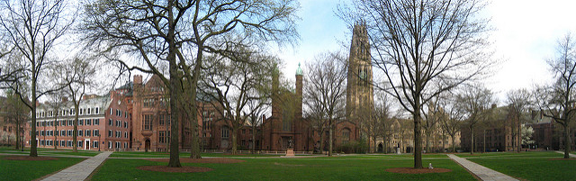
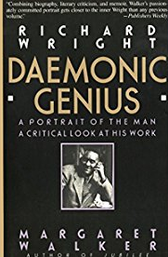
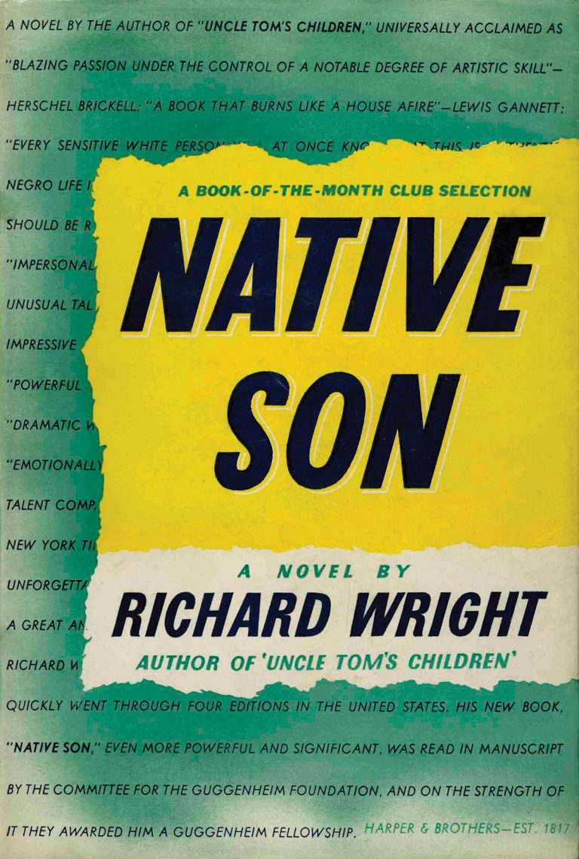
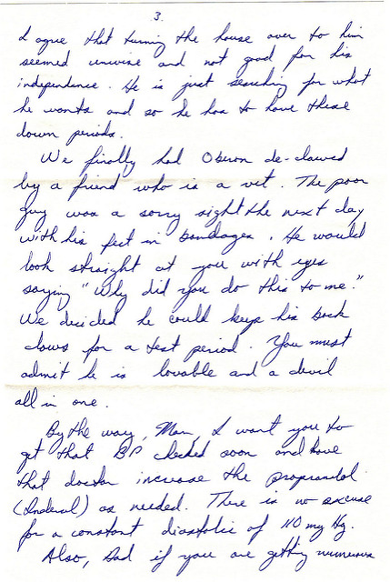
Wright v. Warner Books, Inc.
Yale University Old Campus by Angelo Mercado is licensed under CC BY NC ND.
Photo from Amazon.com
Letter by K P is licensed under CC BY.
Native Son by Richard Wright 1938 book cover. Retrieved Feb. 21, 2018 from http://200.hc.com/timeline/1938-harper-brothers-publishes-richard-wrights-debut-story-collection/

Slide 6
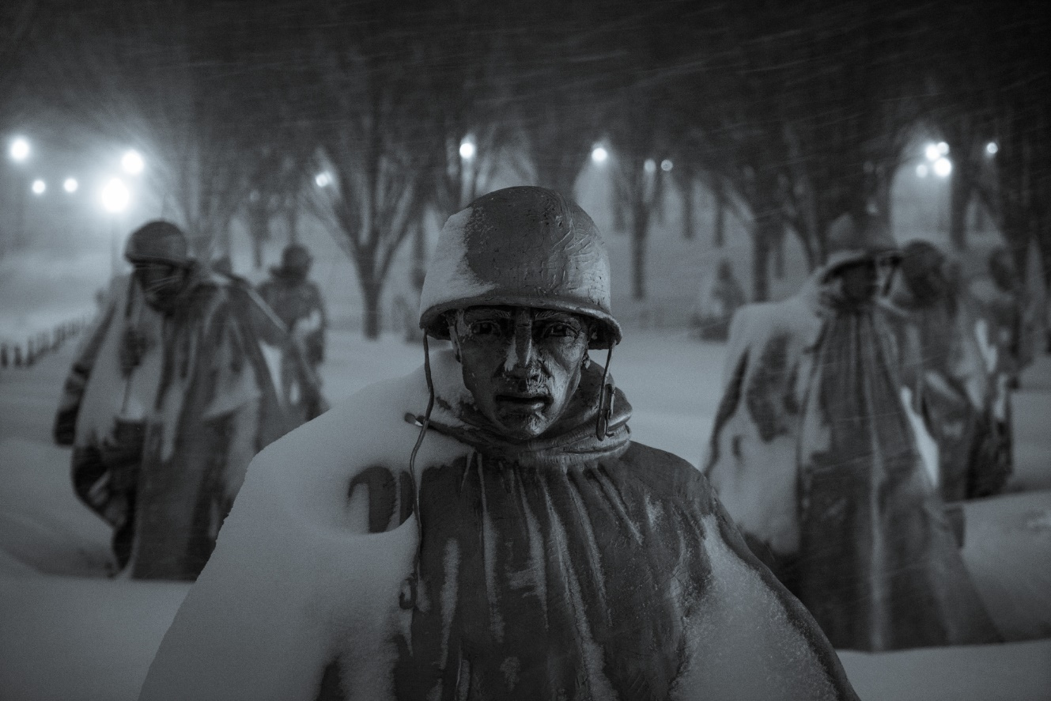
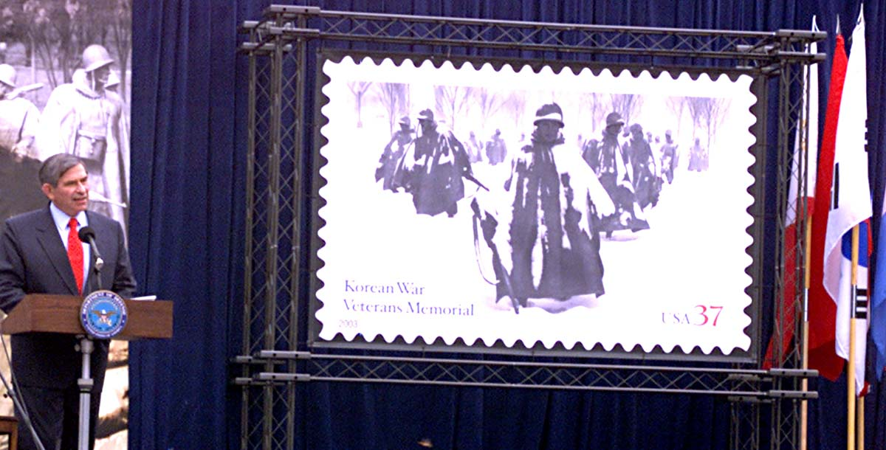
Gaylord v. United States
Deputy Defense Secretary Paul Wolfowitz spoke at the July 27, 2003, Postal Service dedication of the Korean War Veterans Memorial stamp on the National Mall. Photo by Rudy Williams. Retrieved Feb. 21, 2018 from US Department of Defense Archive.
A soldier leads his men through the snow at the Korean War Memorial by Jason Vines is licensed under CC BY NC.

Slide 7

Fox News Network v. TVEyes
TVEyes homepage. Retrieved Feb. 21, 2018 from www.tveyes.com.

Slide 8
Thank you!

